Slide 1
Laziness and Obesity
By: Jacky Conrad and Mya Price

Slide 2
Introduction
The stereotype we researched is overweight and obese people are considered lazy.
Found examples of our stereotype in the media
Studied the social disadvantages, health risks, and the role of genetics
Polled our peers to see if the stereotype was true

Slide 3
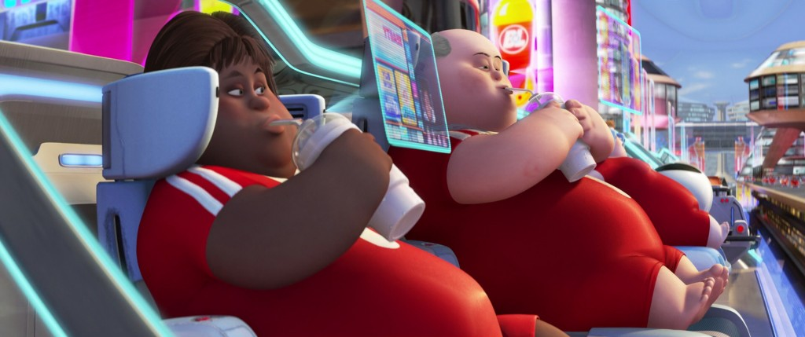
Media - WALL-E

Slide 4
WALL-E
Depicts an entire society of obese people who would be unable to function in the world we live in today
They are immobile without their chairs due to extreme lack of physical activity
Everything is easily accessible and daily life requires no effort
Unaware of their surroundings
No real interaction with other people on the Axiom, only communication is through their screens

Slide 5
Media - Sedentary

Slide 6
Sedentary
Commercial argues that lack of exercise causes weak bones, but did they need to use an overweight child to get their point across?
Compares current generation to older generation, could be linking modern conveniences and laziness
This kid will do anything to avoid physical activity
Clears the leaves with a leafblower while sitting on a chair
Walks the dog by putting it on a treadmill
Calls his grandma on the phone to ask her to get another grape soda
Claps to turn off lights

Slide 7
Media - Pitch Perfect

Slide 8
Pitch Perfect
The character Amy is arguably the funniest person in the movie
She refuses to participate in the Barden Bella’s workout routine and is caught “horizontal running”
Refers to herself as Fat Amy as a defense mechanism against people who would judge her because of her weight

Slide 9
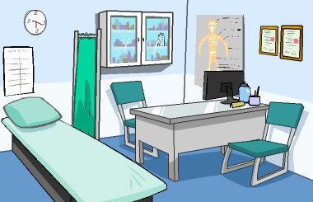
Literature Review
Weight Bias
Negative view of overweight people can be found in schools, doctors offices, and the workplace
“Obese Adults have higher rates of depression, anxiety, social isolation, and poorer psychological adjustment”(“Obesity”).

Slide 10
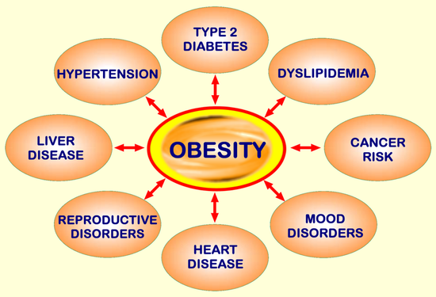
Literature Review
Health Risks
Overweight individuals are more at risk for “cardiovascular disease, type 2 diabetes mellitus, hypertension, stroke, dyslipidemia, osteoarthritis, and some cancers” (Must).
Treatment
Constantly told to lose weight, yet many lack the proper guidance and support to see results (Thomas).
“A multidisciplinary approach to the treatment of obesity that addresses psychological, social, environmental, and biological factors is critical to ensure comprehensive care, as well as best practices and outcomes”(Collins).

Slide 11
Literature Review
Genetics
“About 80% of the variation in body weight is determined by genes”(Linden).
Dramatic change in diet when compared to our hunter gather days.
Our mind is programed to crave sweet and fatty foods so we can survive starvation (Linden).

Slide 12
Personal Research
Survey was given out electronically and physically to 50 students of South Lyon High School
They were asked to compare two pictures of women, one being overweight and the other being an average weight
They were also given a space to write other traits they associated with obese people. Some of the more common words included:
Funny
Introverted / Outcast
Lazy
Depressed

Slide 13
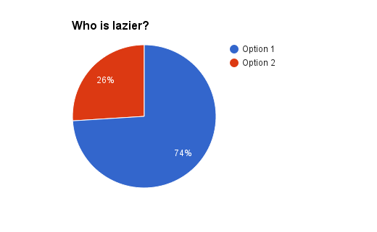
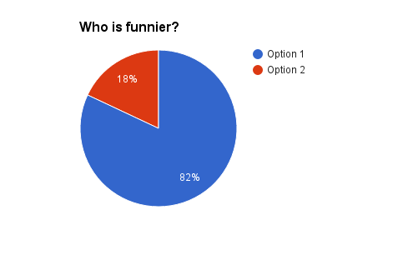
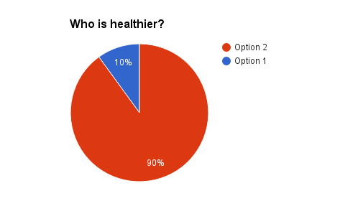
Results

Slide 14
Conclusion
We found that the stereotype is accepted by the majority of people. However, there was no concrete proof that allows us to say laziness is a cause of or a result of obesity.
Obesity is caused by many different factors and weight lost was shown to be harder for some because of genetics. Lack of support makes losing weight harder still and the shame that can be felt is detrimental to their mental health.

Slide 15
What Can We Do?
People lack compassion and sensitivity toward the issue of obesity. If this stereotype, along with many others, is going to go away then people need to treat others as individuals and not judge someone before knowing them.
There are plenty of lazy people who are not overweight and people who are overweight but are actively trying to lose weight.
Health professionals should have more understanding and make their facilities more accessible.
The public should be more aware of the role of genetics and stop shaming people for being unable to lose weight.
There should also be a push for healthier foods to be more accessible and less expensive than fatty foods.

Slide 16
Work Cited
American Academy of Orthopaedic Surgeons. "Sedentary." YouTube. YouTube, 12 Mar. 2009. Web. 16 Dec. 2016.
Collins, Jennifer C., M.A., M.S., and Jon E. Bentz, Ph.D. "Behavioral and Psychological Factors in Obesity." Journal of Lancaster General Health.
2009. Web. 16 Dec. 2016.
Linden, David. "Genetics Drives Obesity: So We Should Stop Judging." <I>USA TODAY</I>. 01 Jun. 2011: A.11. <I>SIRS Issues Researcher.</I>
Web. 09 Nov. 2016.
Moore, Jason, Anna Kendrick, Skylar Astin, Rebel Wilson, Adam DeVine, Anna Camp, Brittany Snow, John M. Higgins, Elizabeth Banks, and
Mickey Rapkin. Pitch Perfect. Universal City, CA: Universal Studios, 2012. 16 Dec. 2016
Must A, Spadano J, Coakley EH, Field AE, Colditz G, Dietz WH. The Disease Burden Associated With Overweight and Obesity. JAMA.
1999;282(16):1523-1529. doi:10.1001/jama.282.16.1523
Stanton, Andrew, Jim Morris, John Lasseter, Pete Docter, Jim Reardon, Thomas Newman, Ralph Eggleston, Stephen Schaffer, Alan Barillaro,
Steven C. Hunter, Jeremy Lasky, Danielle Feinberg, Ben Burtt, Elissa Knight, Jeff Garlin, Fred Willard, John Ratzenberger, Kathy Najimy, and Sigourney Weaver. Wall-e. Burbank, Calif: Walt Disney Home Entertainment, 2008. 16 Dec. 2016.
"Obesity, Bias, and Stigmatization." The Obesity Society. N.p., n.d. Web. 16 Dec. 2016.
Thomas, Samantha L., Jim Hyde, Asuntha Karunaratne, Rick Kausman, and Paul A. Komesaroff. ""They All Work...when You Stick to Them": A
Qualitative Investigation of Dieting, Weight Loss, and Physical Exercise, in Obese Individuals." Nutrition Journal. BioMed Central, 24 Nov. 2008. Web. 16 Dec. 2016.

